Slide 1
National Decarbonization Policy in Costa Rica: Capacity Building for Global Climate Change
By Cassia Rodrigues (UID: 119129180)
Notes:
Costa Rica, a small Central American nation, is celebrated for its rich biodiversity, stunning landscapes, and a commitment to environmental conservation. Nestled between Nicaragua to the north and Panama to the south, Costa Rica is bordered by the Pacific Ocean to the west and the Caribbean Sea to the east. The country is renowned for its lush rainforests, diverse ecosystems, and an abundance of wildlife, making it a haven for nature enthusiasts and ecotourists
Costa Rica is unique not only for its natural beauty but also for its progressive stance on environmental sustainability. It has set itself apart by aiming to become one of the world's first carbon-neutral nations.

Slide 2
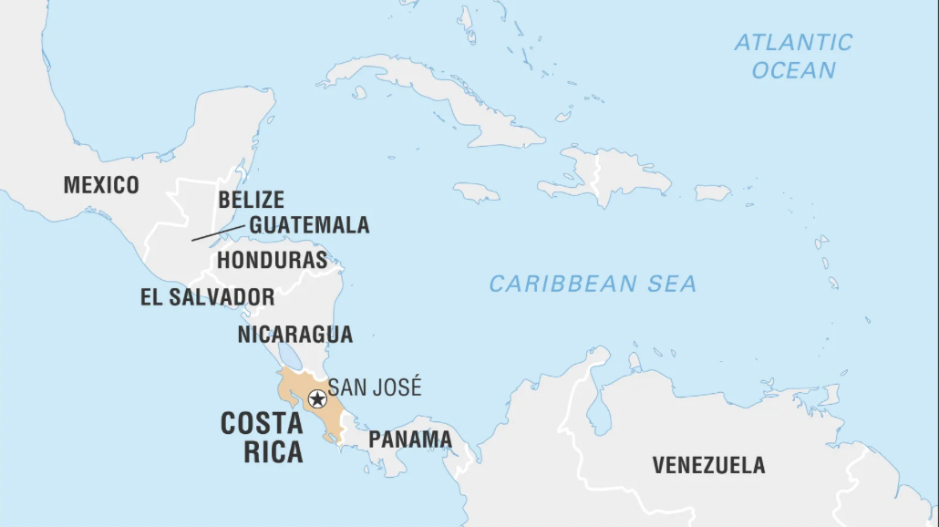


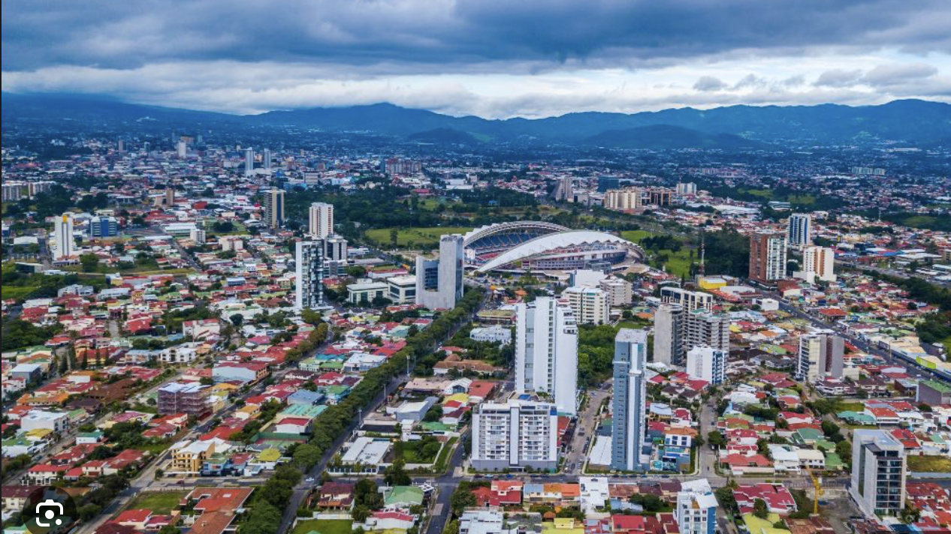

Slide 3

Costa Rica Vision
President Alvarado has a clear vision of the city of the future. “I imagine a city where mobility is based on clean energy; a city that bets on technology but prioritizes people’s well-being, freedom, and right to privacy; a city where you breathe clean air; a city that manages waste sustainably and a city where you are in contact with nature to find peace of mind,” he said.
Implementing the National Decarbonization Plan is expected to bring USD 41 billion in net benefits to the Costa Rican economy between 2020 and 2050.

Slide 4

What is Capacity Building?
Capacity building refers to the process by which individuals or organizations obtain, improve, or retain the skills, knowledge, tools, equipment, or other resources to do their work competently. It also refers to further developing the performance and thus leading to greater capacity. Capacity building and capacity development are often used interchangeably.
Capacity building in other words is an investment in the effectiveness and future sustainability of the society.
https://climate-adapt.eea.europa.eu/en/metadata/adaptation-options/capacity-building-on-climate-change-adaptation

Slide 5
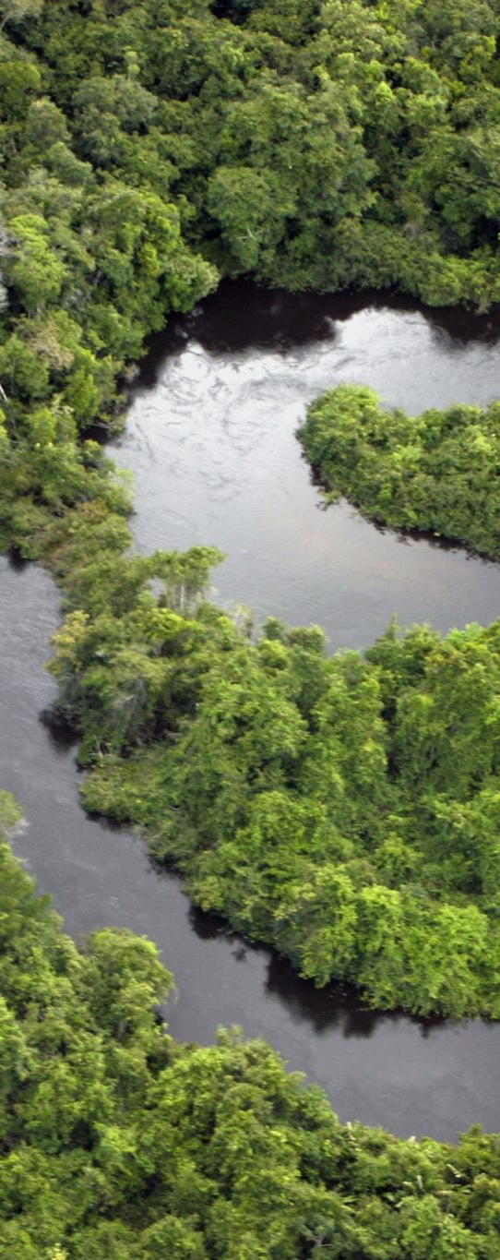
The National Decarbonization Plan
The NDP published in 2019 by the government of Costa Rica sets the goal of becoming carbon-neutral by 2050, with Costa Rica’s local emissions being offset by the local absorption provided by forests and other carbon sinks.
The NDP proposes a set of actions organized around ten “lines” representing Costa Rica’s main economic and infrastructure sectors.
Bold mid- and long-term targets to reform transport, energy, waste, and land use, were launched in February of 2019.
The aim is to achieve net zero emissions by 2050, meaning the country will produce no more emissions than it can offset through actions such as maintaining and expanding its forests.
Costa Rica’s most important climate policy is its National Decarbonization Plan, and the latest update report shows that almost all the original planned actions are on track, despite the negative effects of the pandemic
Funded by the Inter-American Development Bank’s (IDB)’s French Climate Fund (RG-T3193) and Sustainable Energy and Climate Change Initiative (RG-T2713).
Notes:
The study built on a collaboration between the University of Costa Rica’s Electric Power and Energy Research Laboratory (EPERLab), the RAND Corporation, the Costa Rica Climate Change Directorate, and the Inter-American Development Bank (IDB). It was funded by the Inter-American Develop- ment Bank’s (IDB)’s French Climate Fund (RG-T3193) and Sustainable Energy and Climate Change Initiative (RG-T2713).

Slide 6
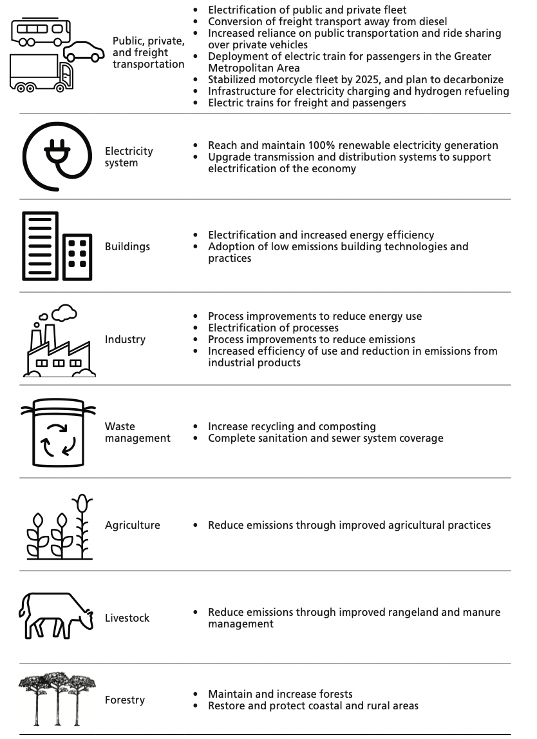
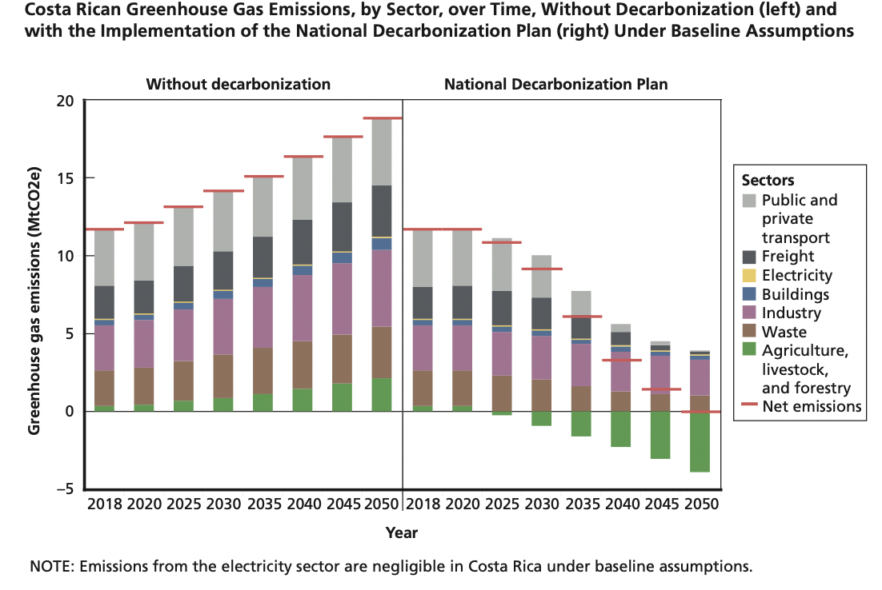
Representative Decarbonization Actions in Costa Rica’s NDP

Slide 7
Literature Review
Böhringer, C., Rivers, N., Rutherford, T., & Wigle, R. (2015). Sharing the burden for climate change mitigation in the Canadian federation. The Canadian Journal of Economics / Revue Canadienne d’Economique, 48(4), 1350–1380.
Beer, C. T. (2014). Climate Justice, the Global South, and Policy Preferences of Kenyan Environmental NGOs. The Global South, 8(2), 84–100. https://doi.org/10.2979/globalsouth.8.2.84
Groves, David G., James Syme, Edmundo Molina-Perez, Carlos Calvo Hernandez, Luis F. Víctor-Gallardo, Guido Godinez-Zamora, Jairo Quirós-Tortós, Felipe De León Denegri, Andrea Meza Murillo, Valentina Saavedra Gómez, and Adrien Vogt-Schilb, The Benefits and Costs of Decarbonizing Costa Rica's Economy: Informing the Implementation of Costa Rica's National Decarbonization Plan Under Uncertainty. Santa Monica, CA: RAND Corporation, 2020.
Notes:
Dividing the burden for greenhouse gas abatement among the provinces has proven challenging in Canada and contributes to Canada's failure to limit emissions. This paper uses a computable general equilibrium model to compare a number of rules for sharing the burden of emission reductions among Canadian provinces.
Negotiations for a global agreement to address climate change have often pitted the nations of the heavily industrialized Global North against the nations of the developing Global South.
3. In this study, we applied a novel methodology for planning under deep uncertainty to evaluate whether the implementation of the NDP makes economic sense for Costa Rica beyond meeting its international commitments—meaning that the benefits exceed the costs for the country. If this is the case, then the NDP is worthy of collective action.

Slide 8
Objective of the study
The idea is to measure how effective the National Decarbonization policy has been in Costa Rica in building a sense of global climate justice equity.
In this study, the success of Costa Rica’s climate actions can enable other developing countries to effectively participate in climate negotiations, access climate finance, and implement climate policies.
To explain the causal relationship between CO2 emissions and GDP. Whether a decrease in CO2 emissions will lead to an increase in GDP in Costa Rica.

Slide 9

Data Collected
Data source: https://databank.worldbank.org/source/world-development-indicators#
Under Databases using the World Development Indicators, Climate and Development Report (CCDR), Sustainable Development Indicators: combining relevant series variables from 1990-2050.
Time Series data
Relevant variables:
CO2 emissions in different sectors
GDP per capita, Unemployment, Poverty Headcount Ratio

Slide 10
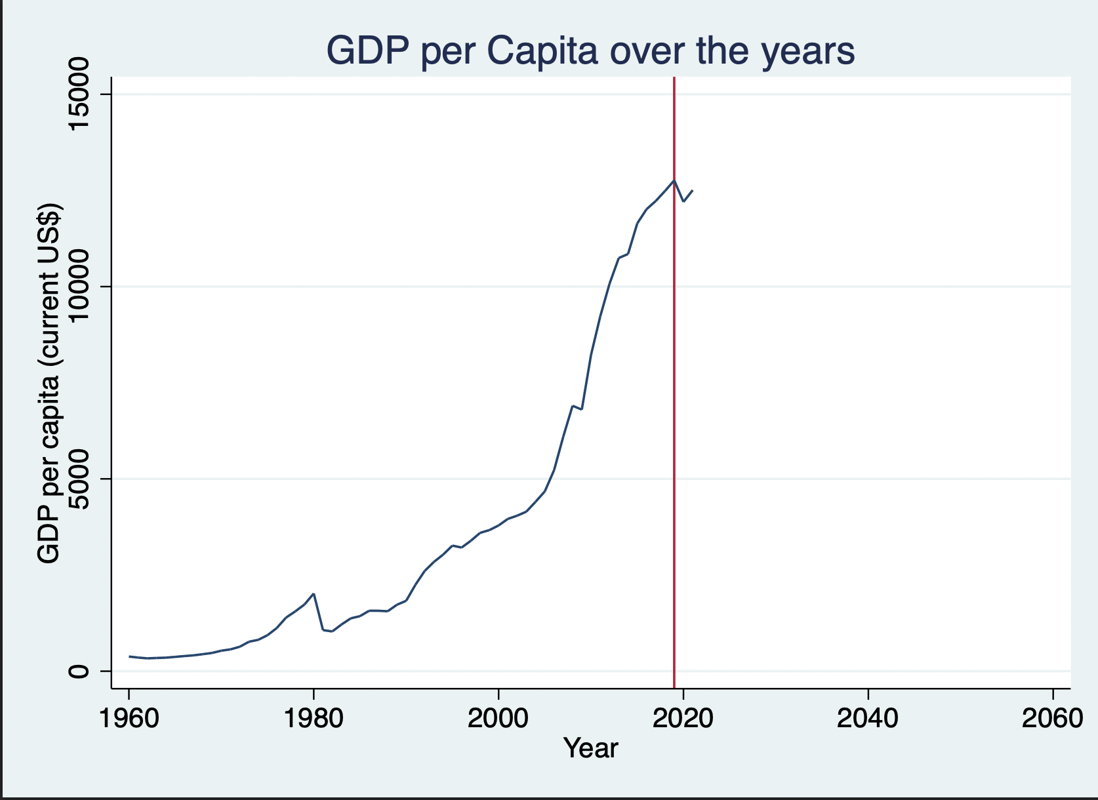
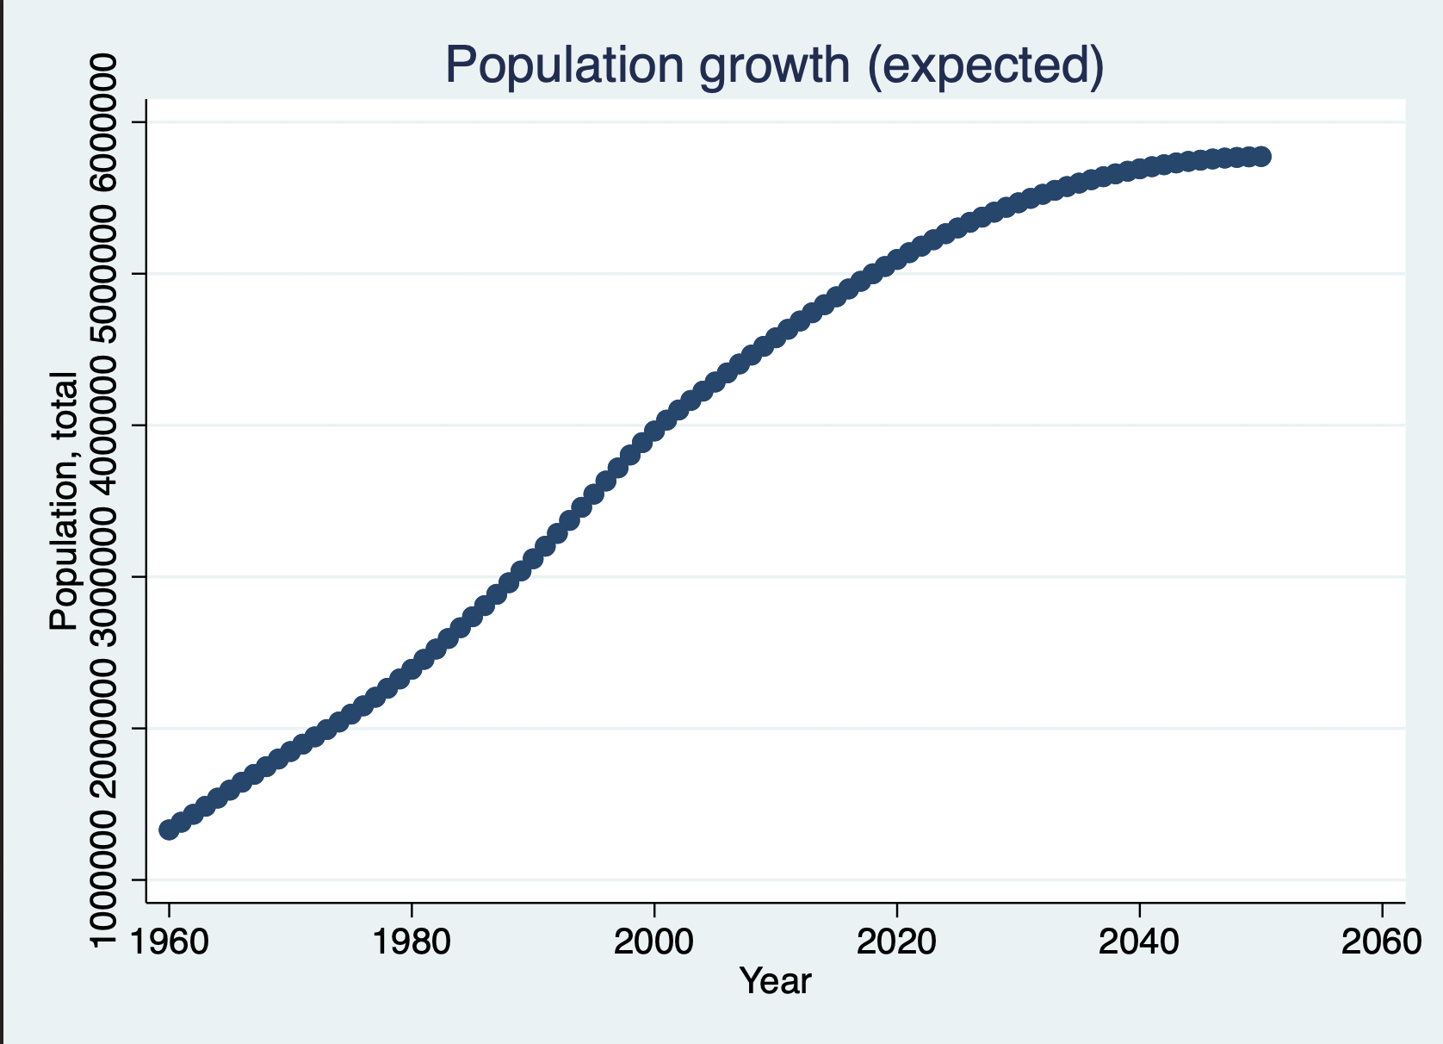
Descriptive Statistics
We see an increase in GDP over the years, a dip in 2019-2020 possibly due to the impact of COVID19
Population growth will see a steady increase until 2050, plateau around 2020-2040 according to estimates

Slide 11
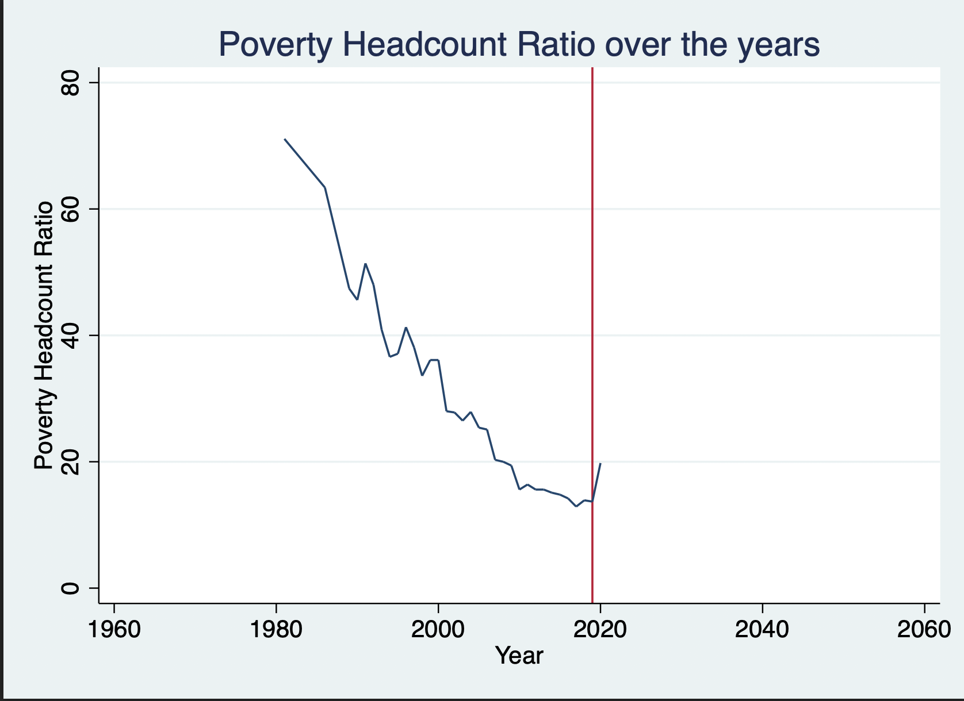
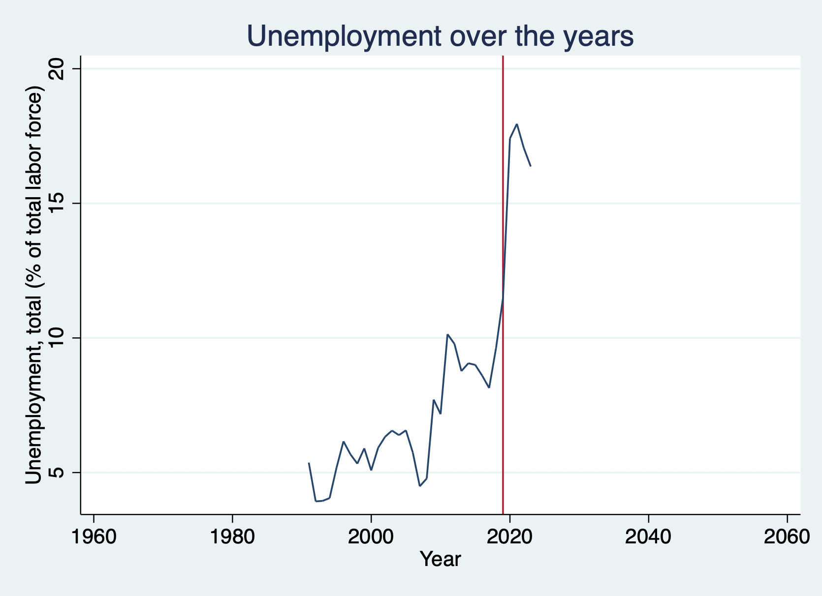
Poverty Headcount Ratio has been on the decline except for some anomaly years, however an uptick in 2020 possibly due to the impact of COVID19
Unemployment has increased between the years 2000-2020, however, we can see a sharp decline post-2020. Could this be due to the new policy?

Slide 12
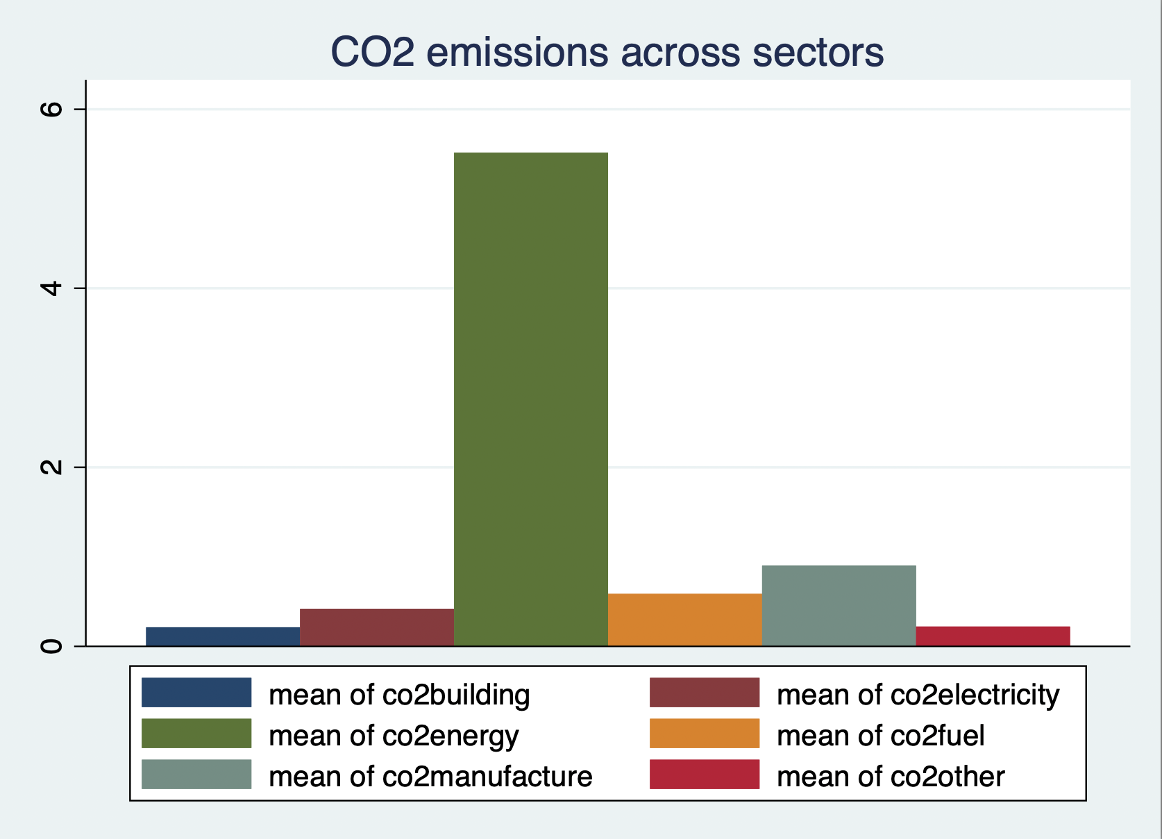
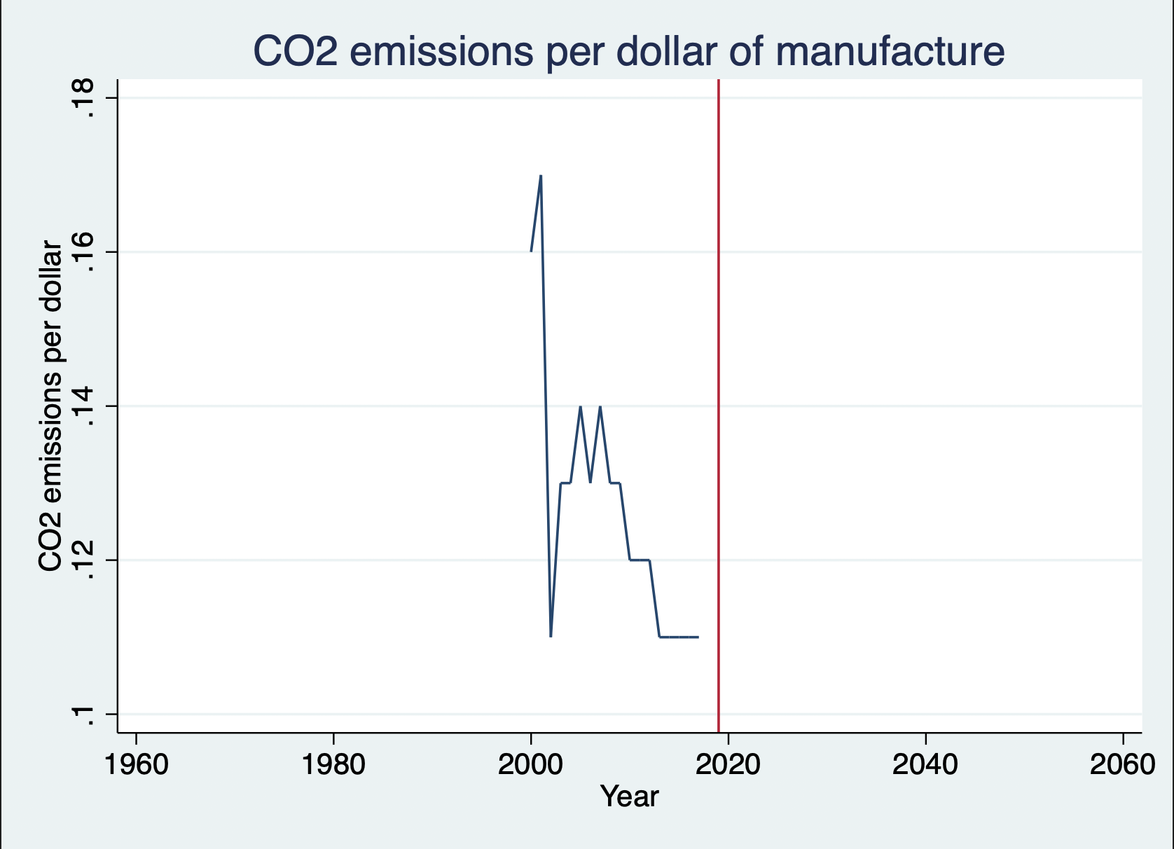
Amongst the industry CO2 emitters, Energy is the highest and building the lowest on average
CO2 emissions have plateaued to the lowest point since 2019

Slide 13
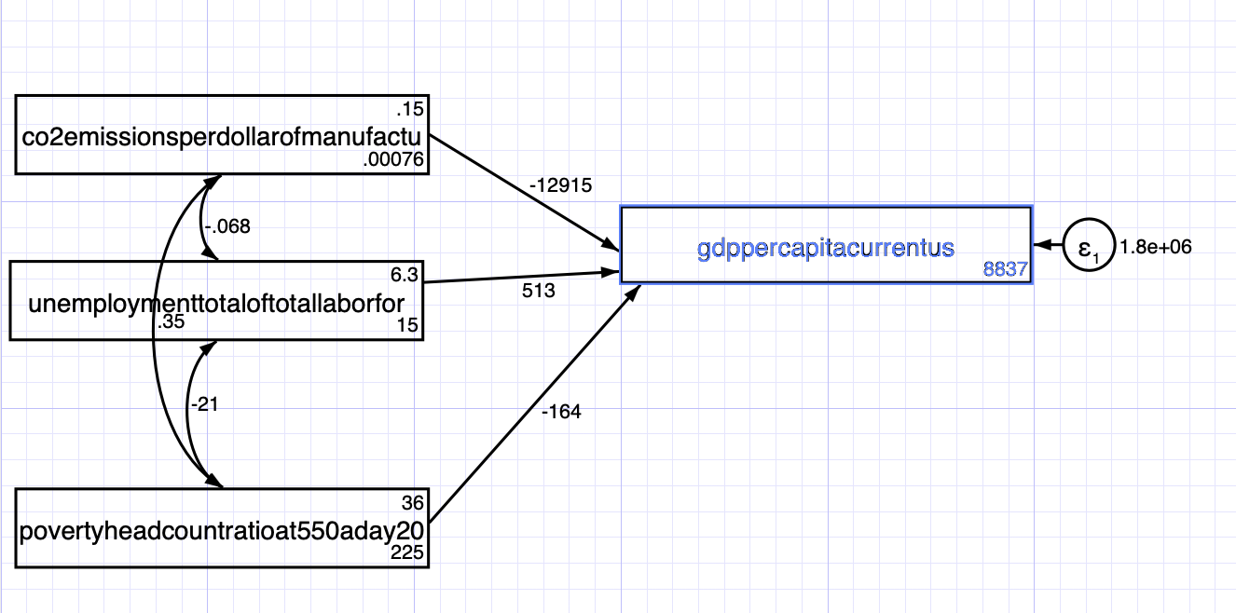
Methodology/Data Analysis
Using the SEM model builder in Stata we aim to show the relationship between Decarbonization, Unemployment, Poverty Headcount Ratio and GDP per capita.

Slide 14
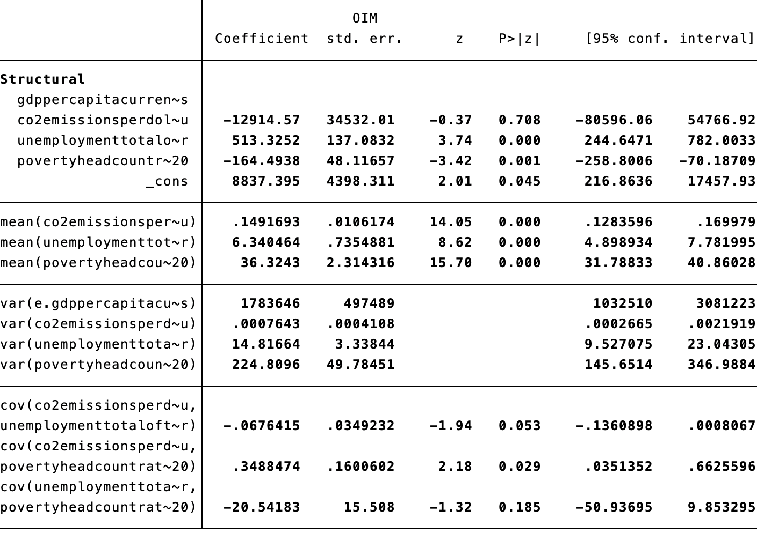
Findings
Notes:
Unemployment and Poverty headcount ratios are significant as the P value is less than 0.05 however CO2 emissions are not.
As increase in C02 emissions in causes a decrease in GDP→ not signification
As unemployment increases GDP also increases.
As poverty headcount increases theres a decrease in GDP

Slide 15

Conclusion
If lowering the carbon levels does in fact lead to an increase in the GDP per capita this provides an incentive to other developing countries to pursue a Decarbonization policy like Costa Rica, however, my analysis does not prove this.
There could be other indicators of CO2 causing an uptick in GDP that I have not accounted for in my analysis like renewable energy sources, innovation and technology adoption, etc. which could probably lead to more robust results.
Lastly, this work also fits into a larger research and policy agenda informing decarbonization throughout Latin America.
Notes:
Lastly, this work also fits into a larger research and policy agenda informing decarboniza- tion throughout Latin America. Specifically, the way of approaching policy analysis that is (1) participatory, (2) accounts for uncertainty through the evaluation of futures, and (3) con- siders trade-offs across various performance sectors and uncertainty is being used elsewhere in Costa Rica and Latin America. The tools, data, and local capacity from this study have already been used for a targeted analysis of Costa Rica’s proposed electric train to inform governmen- tal decisions on an approximately $500 million loan for the project (Dirección de Cambio Climático). The same RDM approach as developed for this study for evaluating national decarbonization strategy is also underway in Chile, Perú, and Colombia.

